Slide 1
Project Preparation

Slide 2
Domain Types for Data Analysis Projects
Financial Services
E-Commerce
Sales
Marketing
Manufacturing
Pharmaceuticals
HR
Aviation
Transportation and logistics
Financial Services
  Banking
  Insurance

Slide 3
Data Search for Projects
Kaggle
Google Dataset
Github
Data.gov
Data.world
BuzzFeed News
FiveThirtyEight
https://towardsdatascience.com/useful-sites-for-finding-datasets-for-data-analysis-tasks-1edb8f26c34d

Slide 4
KPI
A Key Performance Indicator is a measurable value that demonstrates how effectively a company is achieving key business objectives.
Organizations use KPIs at multiple levels to evaluate their success at reaching targets.
High-level KPIs may focus on the overall performance of the business, while low-level KPIs may focus on processes in departments such as sales, marketing, HR, support and others.

Slide 5
KPIs - Sales
1. Monthly sales growth
2. Monthly sales/new customers
3. Monthly new leads/prospects
4. Number of qualified leads
5. Resources spent on one non-paying client
6. Resources spent on one paying client
7. Customer lifetime value/customer profitability
8. Lead-to-sale conversion rate
9. Cost per lead by each channel
10. Cost of a new client by each channel
11. Hourly, daily, weekly, monthly, quarterly, and annual sales
12. Average conversion time
13. Lead-to-close rate: all channels
14. Customer turnover rate
15. Number of monthly sales demos
16. Customer engagement level
17. Number of abandoned shopping carts
18. Shopping cart abandonment rate
19. Number of monthly quotes/orders
20. Average purchase value
21. Average order value
22. Sales per representative
23. Sales by lead source
24. Inbound calls handled per representative
25. Outbound calls handled per representative
26. Average annual sales volume per customer
27. Average monthly sales volume per customer
28. Relative market share
29. Product/service usage every day
30. Value of returned goods and warranties
31. Asset turnover ratio (sales to assets)
32. Percentage of total sales from existing customers
33. Sales reps per $100k in revenue
34. Monthly sales quota attainment
35. Sales quota attainment by the sales representative
36. Number of client accounts per account manager
37. Days sales outstanding

Slide 6
KPIs - Financial
38. Net profit margin
39. Operating cash flow (OCF)
40. Current ratio
41. Quick ratio / Acid test
42. Net profit margin
43. Working capital
44. Current accounts receivable
45. Current accounts payable
46. Accounts payable turnover
47. Accounts receivable turnover
48. Accounts payable process cost
49. Accounts receivable turnover
50. Budget variance
51. Budget creation cycle time
52. Line items in the budget
53. Number of budget iterations
54. Payroll headcount ratio
55. Vendor expenses
56. Payment error rate
57. Internal audit cycle time
58. Finance error report
59. Debt to equity ratio
60. Return on equity
61. Cost of managing business
62. Resource utilization
63. Total cost of the finance function

Slide 7
KPIs - Project Management
64. Planned value (PV)
65. Actual cost (AC)
66. Earned value (EV)
67. Cost variance (CV) (planned budget vs. actual budget)
68. Schedule variance (SV)
69. Schedule performance index (SPI)
70. Cost performance index (CPI)
71. Planned hours of work vs. actual situation
72. Overdue project tasks / crossed deadlines
73. % of overdue project tasks
74. Missed milestones
75. Percentage of projects completed on time
76. Percentage of cancelled projects
77. Percentage of projects on budget
78. Number of budget iterations
79. Percentage of tasks completed
80. Project resource utilization
81. Cost of managing processes
82. Return on investment (ROI)

Slide 8
KPIs - Marketing
83. Monthly new leads/prospects
84. Qualified leads per month
85. Marketing qualified leads (MQL)
86. Sales-accepted leads (SAL)
87. Sales qualified leads (SQL)
88. Cost per lead generated
89. Net promoter score
90. Cost per conversion
91. Cost per conversion by channel
92. Average time of conversion
93. Retention rate
94. Attrition rate
95. Monthly website traffic
96. Traffic from organic search
97. Returning vs. new visitors
98. Visits per channel
99. Average time on page
100. Click-through rate on web pages
101. Pages per visit
102. Conversion rate for call-to-action content
103. Inbound links to website
104. Traffic from organic search
105. New leads from organic search
106. New leads from organic search
107. Number of unique keywords that drive traffic
108. Keywords in top 10 SERP
109. Rank increase of target keywords
110. Conversion rate per keyword

Slide 9
KPIs - Marketing
111. Page authority
112. Google PageRank
113. Volume of traffic from video content
114. Leads & conversions from paid advertising
115. Number of monthly PPC campaigns
116. Cost per acquisition (CPA) & cost per conversion (CPC)
117. Click-through rate on PPC advertising
118. Traffic from social media
119. Number of leads from social media
120. Number of conversions from social media
121. Conversion rate for social media leads
122. Managed audience size
123. Engagement rate
124. Social media mentions
125. Social media ROI
126. Content quality on blog
127. Number of monthly blog visits
128. Blog articles published this month
129. E-books published this month
130. Infographics published this month
131. ROI per content type
132. Web traffic from PR campaigns
133. Number of clippings
134. Calls from PR campaigns
135. Media impressions from PR campaigns
136. PR ROI

Slide 10
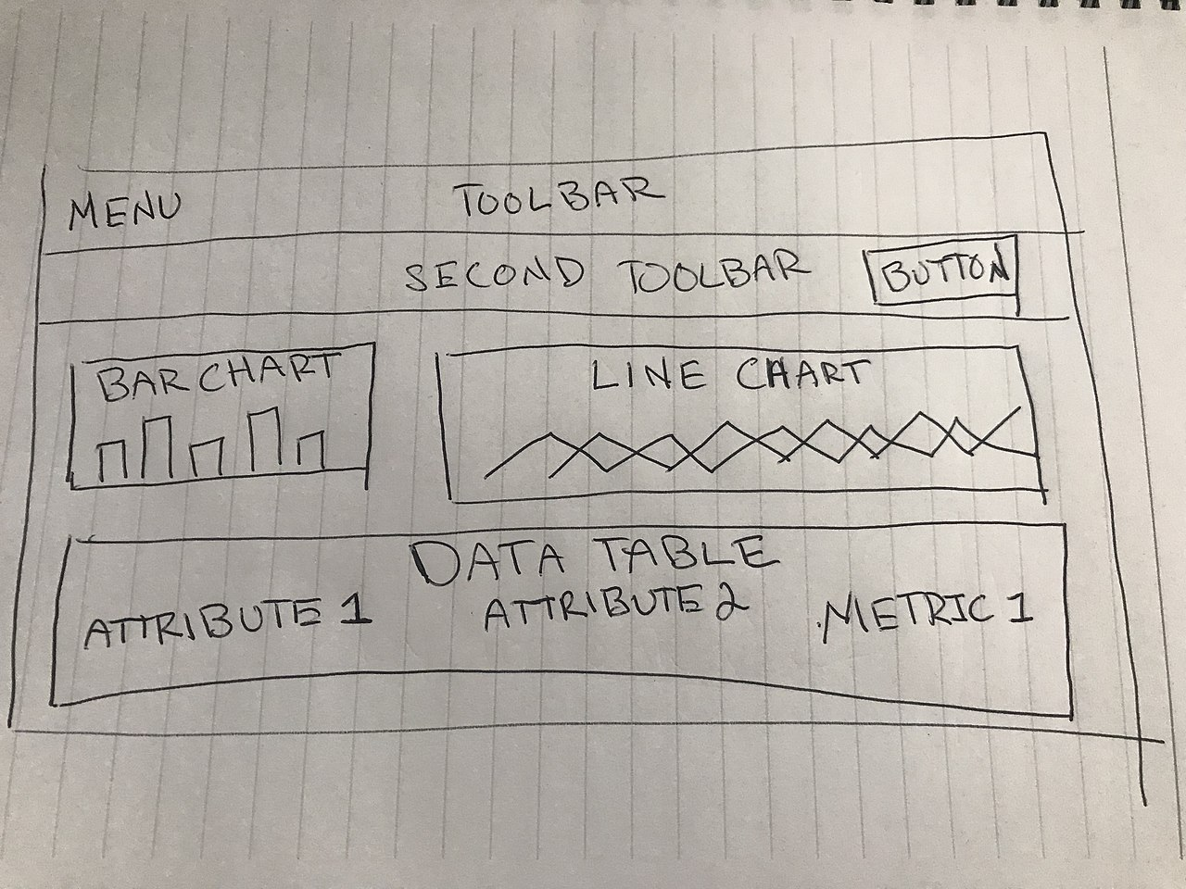
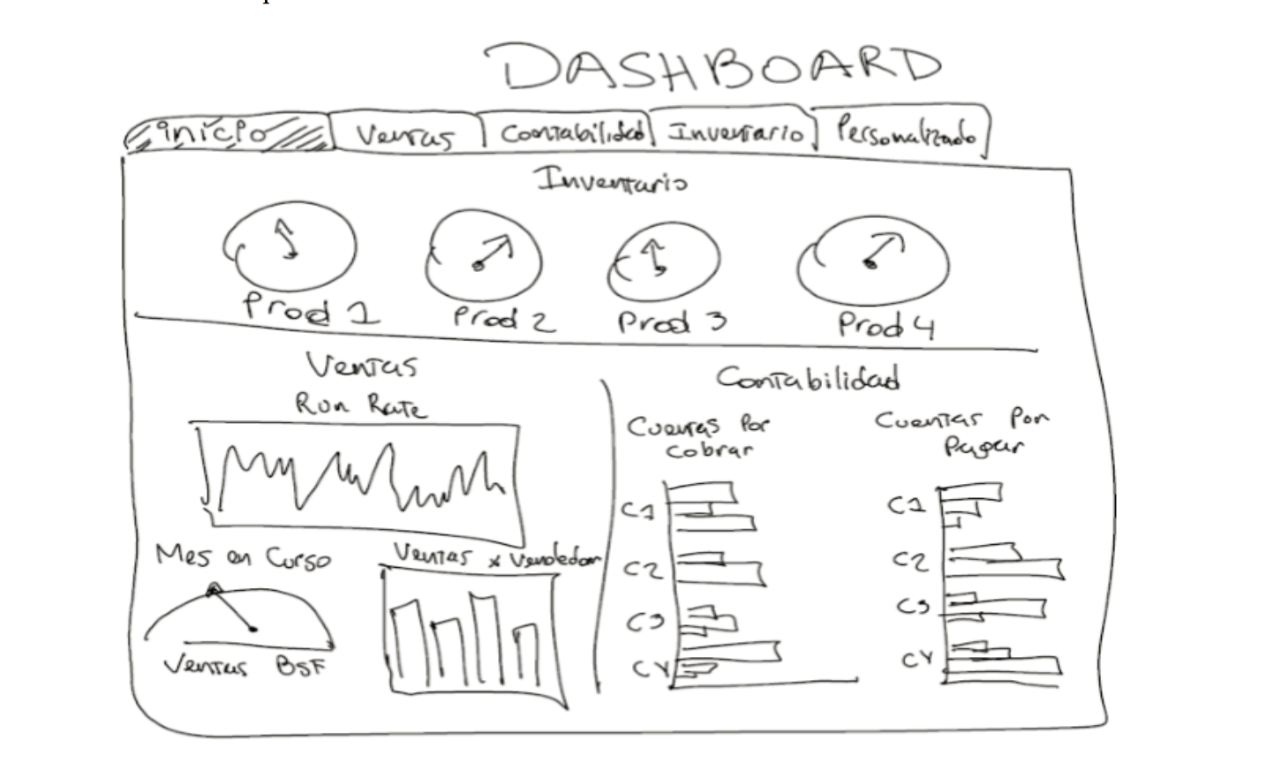
Dashboards & Charts

